Slide 1

School’s Infrastructure Analysis
Prepared by
Linxsly ALEXIS

Slide 2

It's a fact that children's education is one of the most important things for Haitians parents.
Story Telling
The lack of data about the infrastructure and the performance of the schools has been a big problem.

Slide 3

Problem to solve
We would like to group the schools according to their vulnerability in relation to their infrastructure and their level of performance.

Slide 4



Target audience
Families who migrate from a department to another one.
The government (MENFP)

Slide 5
Data source
MENFP
Ministère de l'éducation nationale et de la formation professionnelle

Slide 6



Methodology
Cleaning data
It’s the most hard part , we remove and replace null values and the wrong values.
Collect data
We receive data from MENFP
We complete the dataset with the data from Ayiti Analytics data
Analysis
We analyze the data We perform a Machine Learning (K- means Clustering)

Slide 7
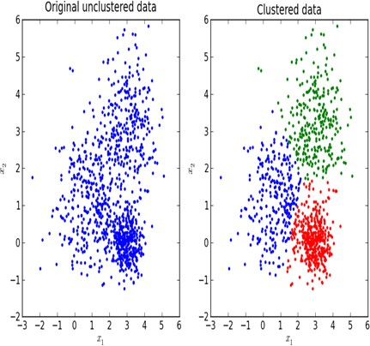
K-Means Clustering
It is a technique that allows us to see the similarity between schools, by grouping them from the point of view of infrastructure and success rate.

Slide 8
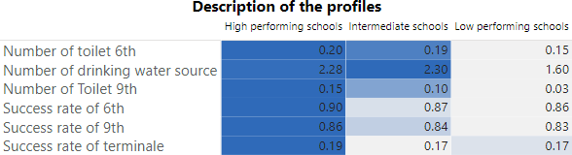
Description of the clusters
This is a description of the three clusters.
The low performing schools have less infrastructures than any other groups.

Slide 9
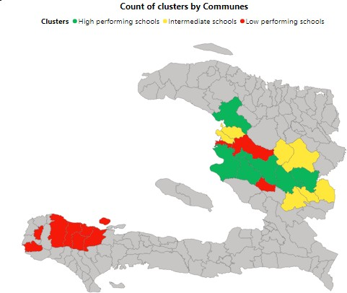

Slide 10
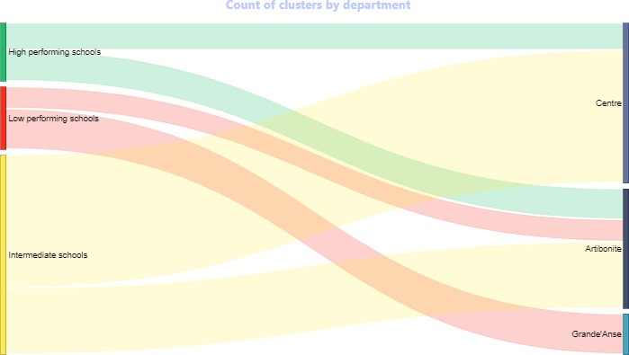
In this graph we can notice the number of clusters by
department. The second profile, which is the worst, is the only one profile to
have school in Grande’Anse. That means, in this department, there are not only an
infrastructure’s problem but also an educational problem.

Slide 11
First page of the dashboard

Slide 12

Recommendations
We will suggest the government to give more grant programs to improve the infrastructure and the level of performance in the municipalities which have low performing schools more specifically in Grand'Anse.

Slide 13




Contact
Linxsly ALEXIS
+509 46976429
alexislinxsly@gmail.com
Project link : https://github.com/alexislinxsly/Cap stone-Project.git

Slide 14


References
MarvelAmazon/repo-data: data repository for bootcamp (github.com) Clustering in R - A Survival Guide on Cluster Analysis in R for Beginners! - DataFlair (data-flair.training)

Slide 15

Thank You
For your attention!

